Slide 1
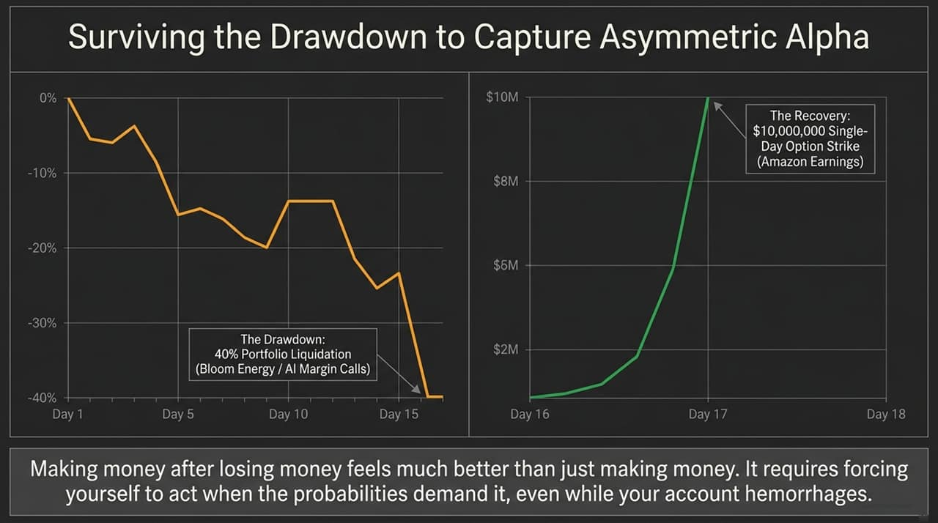
Notes:
Welcome, everyone. Looking at the charts on this slide, you’re seeing two extremes of a single 18-day window. On the left, a brutal 40% drawdown driven by forced liquidations and margin calls across AI positions like Bloom Energy. On the right, a massive $10,000,000 single-day recovery triggered by a high-conviction options execution around Amazon earnings.
Most people look at a chart like this and see extreme volatility or luck. But as Chris Camillo discussed on The Iced Coffee Hour, making money after enduring a severe drawdown feels fundamentally different than simply coasting on gains. It requires executing cold, probabilistic calculations precisely at the moment when your emotions—and your account balance—are screaming at you to capitulate.
True asymmetric alpha isn’t captured by avoiding drawdowns entirely; it is captured by surviving them with your conviction intact and striking when the risk/reward ratio skews heavily in your favor.
Key Points to Emphasize:
Contrast between emotional panic and rational, probabilistic execution.
Context: Surviving 40% account drawdowns requires pre-calculated risk limits, not impulse reactions.
https://www.youtube.com/watch?v=ahQlC54rqhk

Slide 2
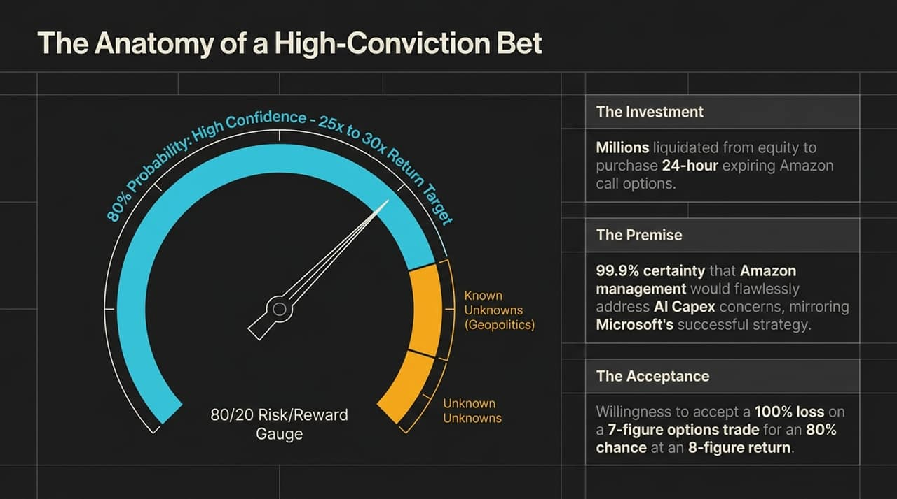
Notes:
Let me walk you through how a multi-million dollar asymmetric trade is structured using the Amazon earnings play as an example.
First, look at the risk/reward gauge on the slide. The premise was based on an 80% confidence level that Amazon management would address market panic surrounding AI capital expenditures in the exact same structured way Microsoft had done days prior. The research didn't point to whether Amazon would beat top-line consensus, but rather how management would frame their AWS and AI growth narrative on the call.
The investment involved liquidating underlying equity positions to fund short-dated, 24-hour expiring call options. The trade carries a binary risk profile: a willing acceptance of a total 100% loss on a 7-figure allocation in exchange for an 80% statistical probability of an 8-figure return.
Notice the yellow segment on the gauge—'Known Unknowns' like geopolitical shocks, and 'Unknown Unknowns'. High-conviction investing never claims 100% certainty; it prices in tail risks and accepts downside ruin on a specific trade without risking total ruin of the core balance sheet.
Key Points to Emphasize:
Probability-based decision-making vs. binary gambling.
The role of short-dated options as leverage multipliers on information edge.

Slide 3
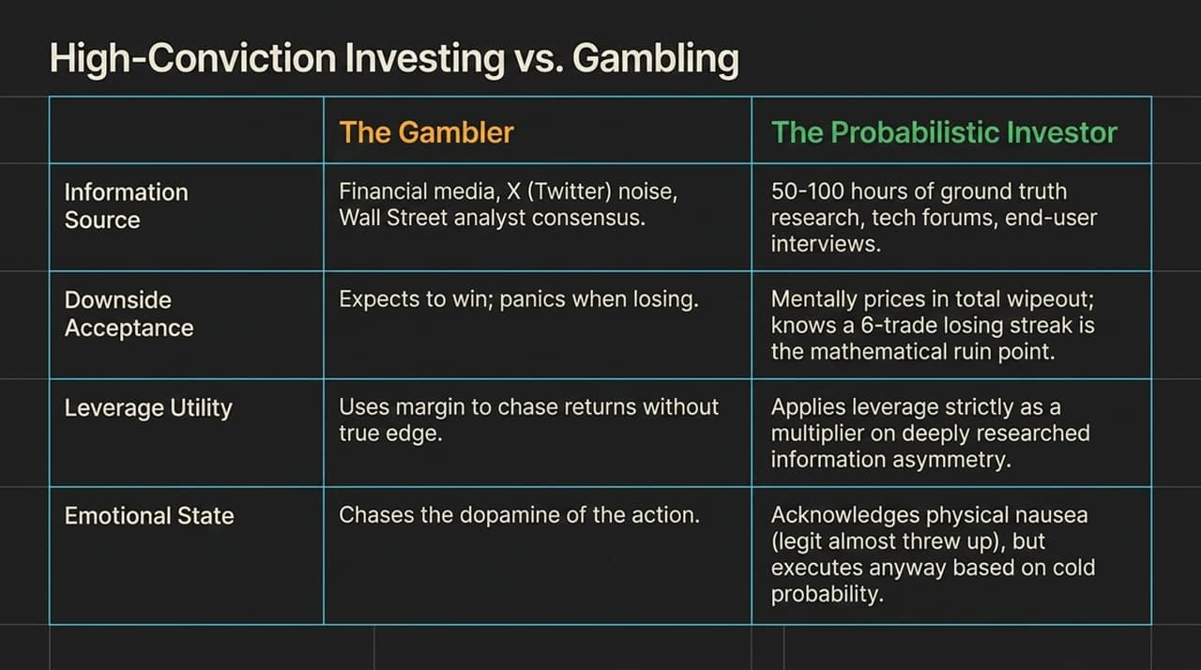
Notes:
It is easy to look at a 24-hour call option trade and dismiss it as gambling. But there is a clear boundary line separating a gambler from a probabilistic investor.
Let's contrast the two across four dimensions:
Information Source: Gamblers react to Wall Street consensus, CNBC, and X (Twitter) noise. Probabilistic investors log 50 to 100 hours of ground-truth research—speaking directly to end-users, developers, and tech forums.
Downside Acceptance: Gamblers expect to win every trade and panic when losses mount. High-conviction traders mentally price in total wipeouts and accept that a losing streak is statistically inevitable over a multi-trade horizon.
Leverage Utility: Gamblers use margin to chase momentum. Probabilistic traders use leverage strictly as an instrument to scale an existing information asymmetry.
Emotional State: As Chris mentioned on the podcast, even with an 80% edge, you feel physical nausea. The difference is that the gambler lets physical nausea dictate action, while the professional acknowledges the emotion and executes based on cold math.
Key Points to Emphasize:
Ground-truth research creates the edge; leverage merely amplifies it.
Emotional detachment under extreme financial pressure.

Slide 4
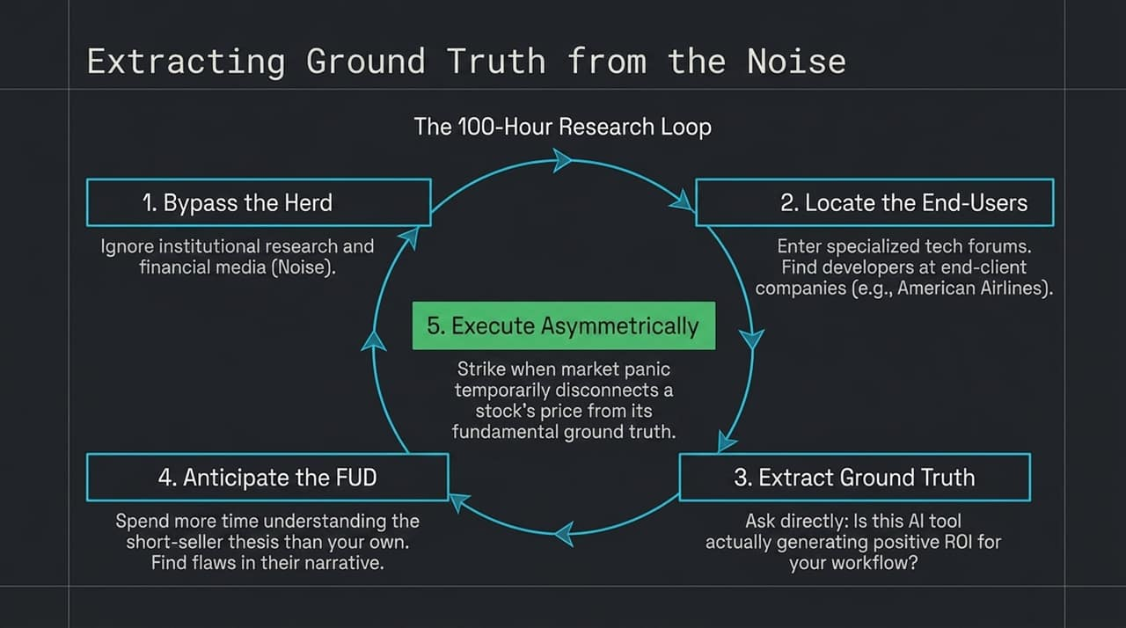
Notes:
So how do you actually establish an information edge? You follow the 100-Hour Research Loop shown here.
Step 1: Bypass the Herd. Mute institutional sell-side reports and financial news networks. They reflect consensus narratives that are already priced into the stock.
Step 2: Locate the End-Users. Go directly to specialized developer platforms, GitHub threads, and industry forums where engineers at companies like American Airlines discuss real software deployments.
Step 3: Extract Ground Truth. Ask direct operational questions: Is this AI tool actually generating measurable ROI for your workflow?
Step 4: Anticipate the FUD. Spend more time dissecting the short-seller thesis than your own long thesis. If you can identify the exact logical flaw in the short narrative before the broader market does, you've found your entry.
Step 5: Execute Asymmetrically. Strike when market panic temporarily disconnects the stock price from fundamental reality.
Key Points to Emphasize:
Differentiating operational reality from financial market sentiment.
The systematic process required before deploying capital.

Slide 5
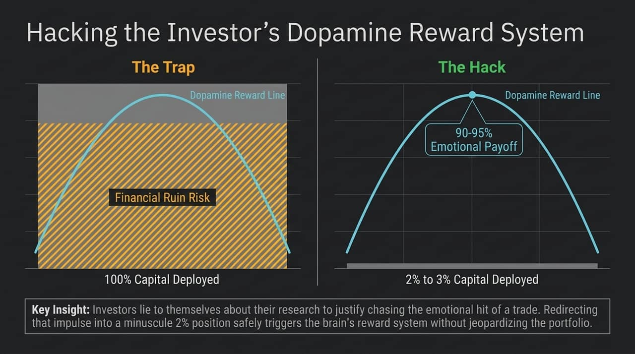
Notes:
One of the biggest psychological traps retail investors face is chasing the dopamine rush of taking risk.
When an investor convinces themselves they have done 'enough research' just to justify getting into a position, they fall into The Trap—deploying 100% of their capital into high-risk trades. This moves their risk exposure straight into the zone of total financial ruin.
Slide 5 illustrates The Hack. You can trigger 90% to 95% of the brain's emotional payoff and dopamine reward while risking only 2% to 3% of your portfolio capital. By restricting speculative, high-dopamine bets to minuscule position sizes, you satisfy the psychological urge for market action without putting your core wealth at risk.
Key Points to Emphasize:
Behavioral finance: separating portfolio management from psychological impulses.
Sizing speculative trades to preserve long-term capital.

Slide 6
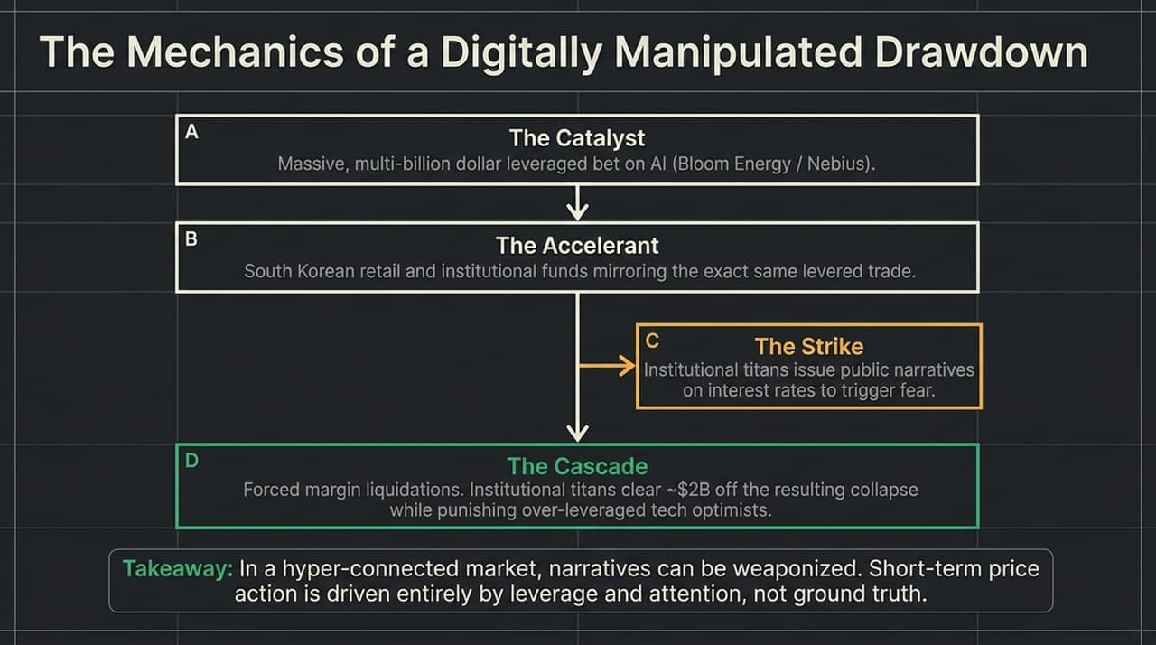
Notes:
"To understand why drawdowns happen so rapidly today, we have to look at the macro structural mechanics. Slide 6 details a classic forced liquidation cascade:
A (The Catalyst): Massive leveraged bets placed on key AI infrastructure plays like Bloom Energy or Nebius.
B (The Accelerant): Retail and institutional derivative flows—such as South Korean leverage products—mirror the trade, creating concentrated long leverage.
C (The Strike): Institutional players or macro macro commentators release narrative headlines around interest rates or capex concerns to spark volatility.
D (The Cascade): The drop triggers automated margin calls, wiping out over-leveraged tech longs and clearing billions in market value.
The core takeaway: In hyper-connected modern markets, short-term price action is frequently driven by leverage mechanics and algorithmic order flows, not shifts in underlying business fundamentals.
Key Points to Emphasize:
Market structure, global leverage linkage, and forced margin liquidations.
Distinguishing temporary liquidity crises from fundamental business decline.

Slide 7
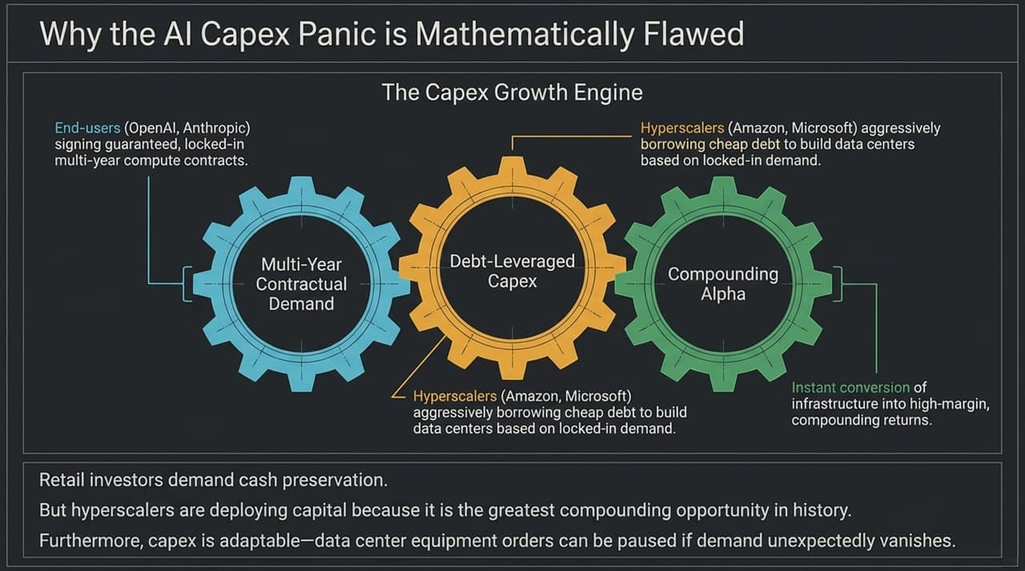
Notes:
Throughout 2024–2026, the media narrative frequently panicked over hyperscaler AI capital expenditure—asking 'Where is the ROI?' Slide 7 demonstrates why that panic is mathematically flawed.
Look at The Capex Growth Engine:
End-users (like OpenAI and Anthropic) sign multi-year, guaranteed compute contracts.
Hyperscalers (Amazon AWS, Microsoft Azure) raise debt capital to build physical data centers backed directly by those locked-in contracts.
Once online, these assets convert infrastructure spend directly into high-margin, compounding recurring revenues.
Retail investors demand immediate cash preservation. Hyperscalers deploy capital because this represents one of the greatest infrastructure compounding opportunities in modern corporate history. Furthermore, data center equipment orders are modular—if demand slows, capex can be adjusted quickly.
Key Points to Emphasize:
Contractually secured demand backing data center expansion.
Long-term economic compounding vs. quarterly market myopia.

Slide 8
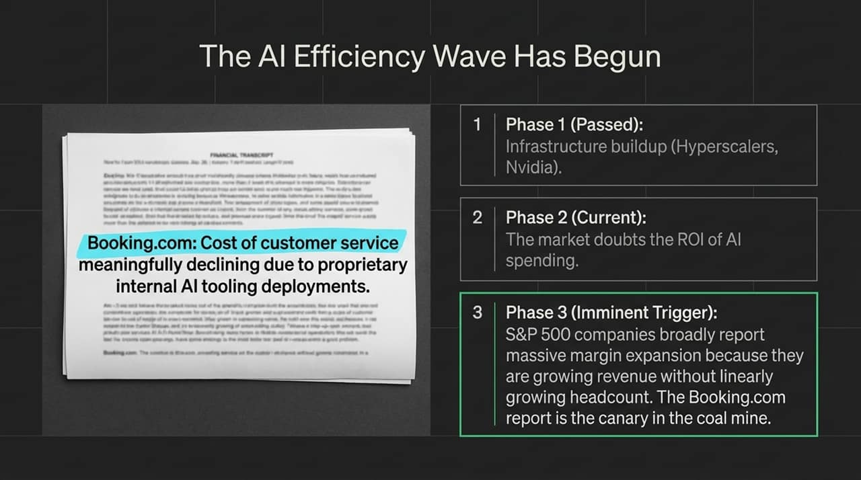
Notes:
Here on Slide 8, we see the real-world validation of the AI cycle. Highlighted on screen is a excerpt from Booking.com's earnings report showing customer service costs declining meaningfully due to internal AI tooling deployments.
We are moving through three distinct phases:
Phase 1 (Passed): Infrastructure buildup—buying chips, servers, and power grid capacity (Nvidia, hyperscalers).
Phase 2 (Current Phase): Market skepticism surrounding immediate software ROI.
Phase 3 (Imminent Trigger): Widespread S&P 500 margin expansion.
When enterprise earnings show revenue expansion alongside flat or declining headcount, the market will re-rate equities sharply upward. Early earnings call metrics—like Booking.com's customer service cost reductions—are the canary in the coal mine for Phase 3.
Key Points to Emphasize:
Transition from infrastructure build-out to corporate margin expansion.
Operating leverage: growing top-line revenue without growing headcount.

Slide 9
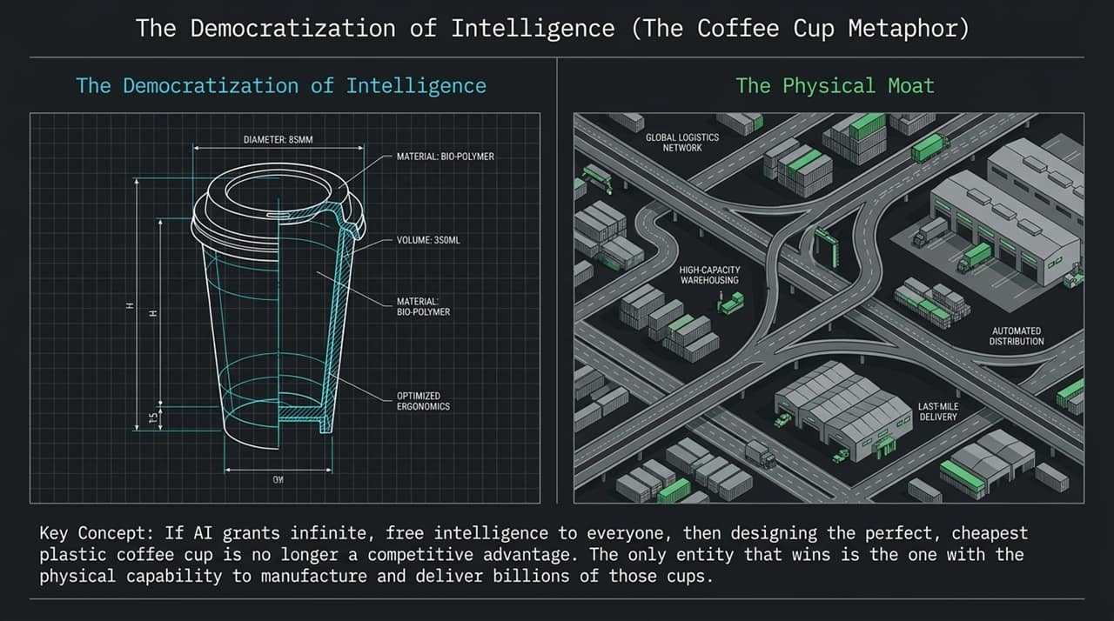
Notes:
Slide 9 presents a core conceptual framework: The Coffee Cup Metaphor.
On the left, you see an engineered bio-polymer coffee cup with optimized ergonomics. On the right, you see global logistics networks, automated distribution, and last-mile infrastructure.
If AI democratizes intelligence—making software engineering, design, and analysis virtually free and accessible to everyone—then designing the 'perfect' cup is no longer a competitive advantage. Anyone can generate the blueprint instantly.
The ultimate winner is the company that owns the physical infrastructure required to manufacture, store, and deliver billions of cups to customers daily. As intelligence trends toward zero cost, competitive moats shift away from pure digital IP and back into physical assets and distribution networks."
Key Points to Emphasize:
Commoditization of digital design and code.
The rise of physical infrastructure as the defensible moat in an AI world.

Slide 10
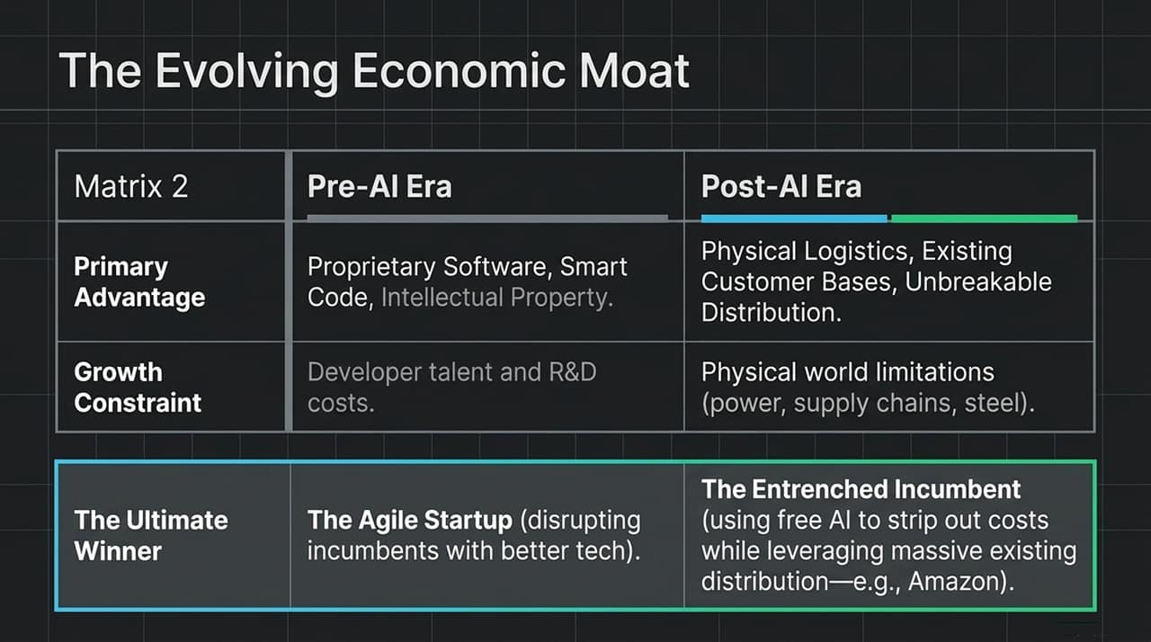
Notes:
Following the Coffee Cup metaphor, Slide 10 summarizes the paradigm shift in corporate moats:
Pre-AI Era: Primary advantage belonged to proprietary software, smart code, and pure digital IP. Growth was constrained by developer hiring costs. The ultimate winners were agile SaaS startups disrupting traditional incumbents.
Post-AI Era: Primary advantage shifts to physical logistics, existing enterprise distribution, and scale. Growth is constrained by physical-world bottlenecks like electricity grid access, supply chains, and specialized hardware.
The ultimate winners in this phase are entrenched incumbents—like Amazon—that can integrate free internal AI capabilities to eliminate overhead while leveraging their unmatched physical distribution networks.
Key Points to Emphasize:
Re-valuation of traditional physical moat assets vs. standalone software platforms.
Why large legacy platforms with physical integration outperform pure-play software startups.

Slide 11
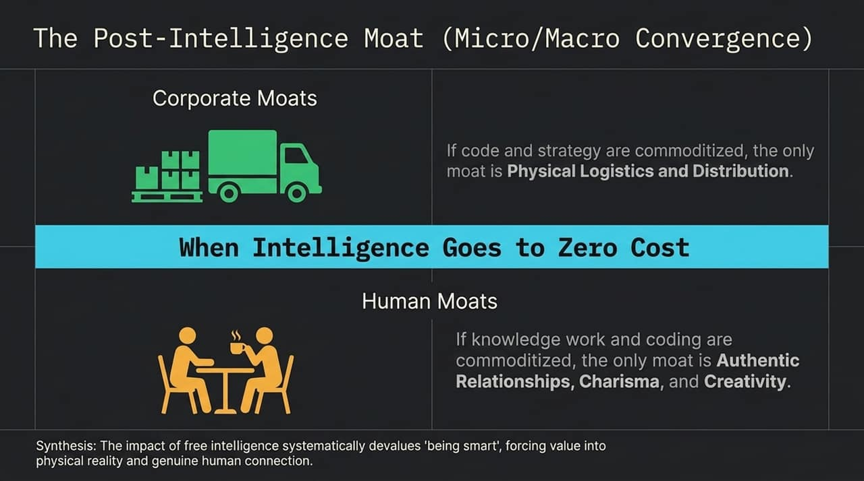
Notes:
Slide 11 takes this transition a step further by bridging corporate strategy with personal career defensibility.
When intelligence approaches zero cost, two moats remain standing:
Corporate Moats: Physical distribution, supply chains, and logistics infrastructure.
Human Moats: Authentic relationships, charisma, trust, and creative vision.
As routine cognitive labor and technical tasks are automated, 'being smart' becomes commoditized. Value flows toward those who control real-world physical assets at the enterprise level, and those who build genuine human trust at the interpersonal level.
Key Points to Emphasize:
Macro economic shifts mirroring individual career strategy.
Emotional intelligence and relationship-building as defensible assets.

Slide 12
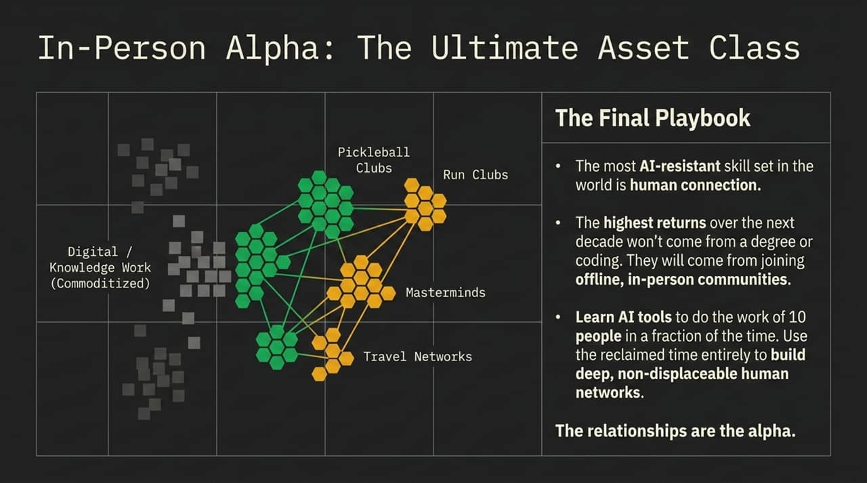
Notes:
Slide 12 lays out the actionable personal playbook in an AI-dominated economy.
Look at the diagram: Knowledge work and purely digital output are being commoditized. The highest-return asset class over the next decade isn't another technical certification—it is offline, in-person communities like local athletic clubs, curated masterminds, and professional travel networks.
The strategy is straightforward:
Leverage AI tooling to execute technical, digital tasks in a fraction of the time.
Reclaim that freed-up time to cultivate deep, non-displaceable offline relationships.
In a world flooded with AI-generated digital noise, trust, access, and face-to-face relationships represent the ultimate un-copyable alpha.
Key Points to Emphasize:
Using AI tools for leverage to buy back personal time.
Building real-world social capital as a hedge against automated labor devaluation.

Slide 13
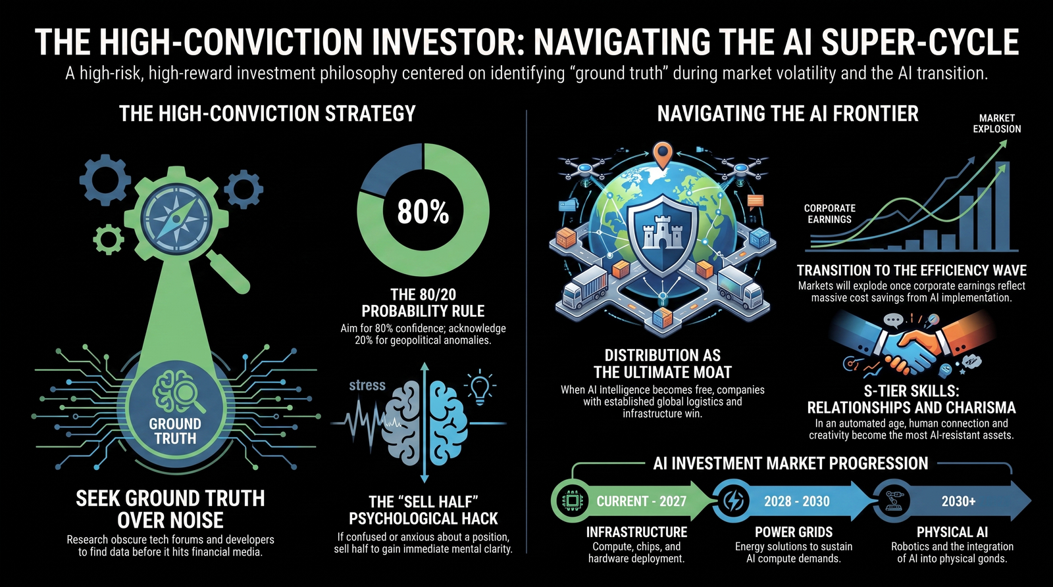
Notes:
To bring everything together, Slide 13 provides an executive summary of the high-conviction philosophy and the road map ahead.
Core Principles:
The 80/20 Rule: Target trades with an 80% confidence edge while accepting the 20% tail risk.
Ground Truth: Filter out media noise by researching end-user reality directly.
The 'Sell Half' Hack: If market volatility clouds your judgment, sell half the position immediately to regain mental clarity.
Distribution & Human Moats: Position capital in companies with physical moats and invest personal time in relationship assets.
AI Investment Progression Timeline:
Current – 2027 (Infrastructure): Data centers, compute chips, and foundational build-out.
2028 – 2030 (Power Grids): Nuclear, clean energy, and power generation required to keep data centers running.
2030+ (Physical AI & Robotics): Bringing AI out of the screen and into physical hardware, logistics automation, and robotics.
Thank you, and I am happy to open the floor to Q&A.
Key Points to Emphasize:
Synthesizing risk management, fundamental research, and long-term macro trends.
The multi-year sequence of the AI build-out from software to power to robotics.

